Slide 1


Introduction to our Smart Watch with Medicine Delivery System
Introducing our cutting-edge smart watch with an integrated medicine delivery system. This innovative device combines advanced health monitoring with automated medication administration, empowering users to better manage their wellbeing.

Slide 2
Innovative Features: Real-Time Health Monitoring and Medication Management
Real-Time Health Tracking
Medication Management
Our smart watch continuously monitors your vital signs, including heart rate, blood pressure, and oxygen levels. It provides instant feedback to help you stay on top of your health.
The built-in medicine compartment stores your daily prescriptions. It dispenses the right dosage at the right time, ensuring you never miss a beat in your treatment plan.

Slide 3
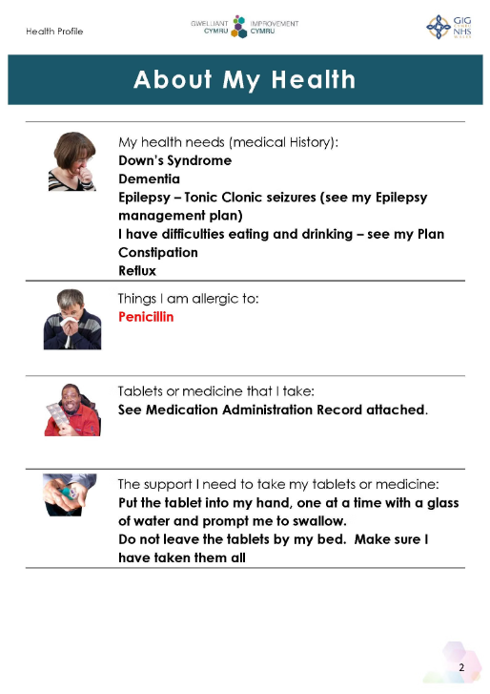
Seamless integration with your personal health profile
Our smart watch seamlessly integrates with your comprehensive personal health profile, allowing you to manage your medications, track your vitals, and communicate with your healthcare providers all from a single, convenient platform.

Slide 4
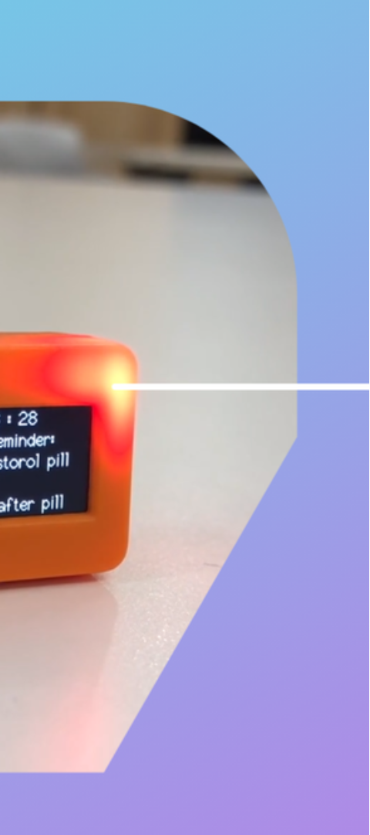
Customizable Medication Reminders and Dosage Tracking
Personalized Alerts
Dosage Tracking
Set custom reminders for your specific medication schedule, ensuring you never miss a dose.
Accurately log the time and amount of each medication taken, helping you stay on top of your regimen.
Adaptive Scheduling
The system adapts to changes in your prescription, automatically updating reminders and dosage records.

Slide 5
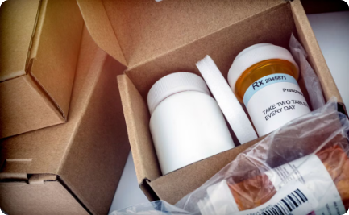

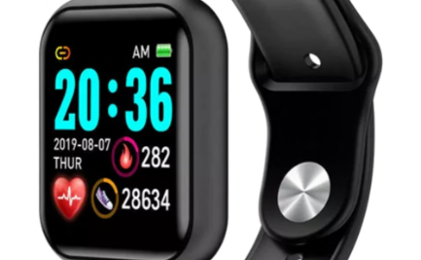
Secure and Discreet Medicine Compartment
Secure Storage
Discreet Access
Personalized Capacity
Our smart watch features a secure, tamper-resistant compartment to safely store your medications, ensuring they remain protected and out of sight.
Access your medications discreetly and conveniently with a simple twist or button press, without drawing unwanted attention or compromising your privacy.
The customizable medicine compartment allows you to store the exact medications and doses you need, tailored to your personal health requirements.

Slide 6



Automated Alerts for Refills and Prescription Updates
Refill Reminders
Prescription Updates
Discreet Alerts
Get timely notifications when it's time to refill your medications, so you never run out.
Stay informed about any changes to your medication regimen, allowing you to manage your health proactively.
Receive discreet notifications on your watch to ensure you never miss an important medication alert.

Slide 7

Connectivity with Your Healthcare Providers
Our smart watch seamlessly integrates with your healthcare providers, enabling personalized care and real-time collaboration. Stay connected to your doctors, share health data securely, and receive tailored recommendations for your well-being.

Slide 8
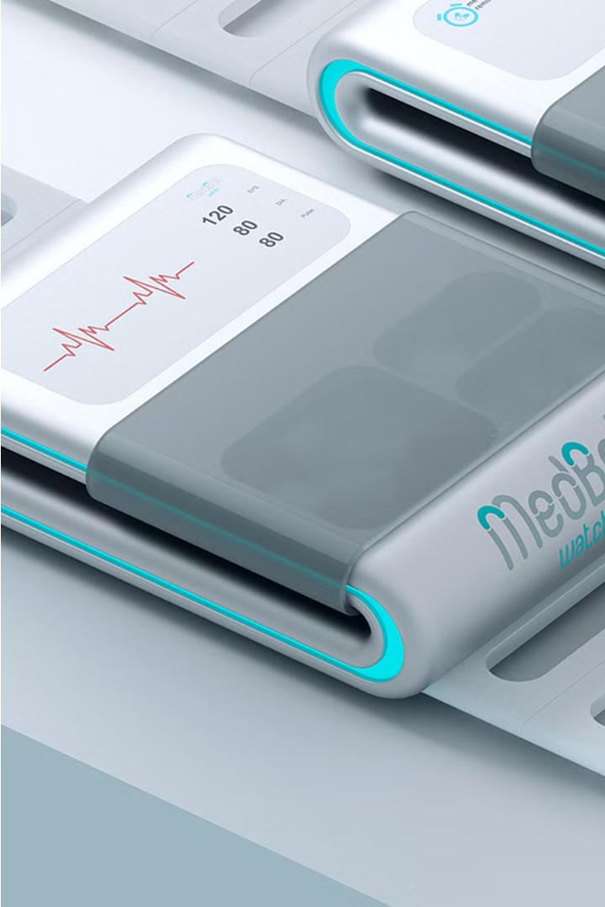
Conclusion and Call to Action
In conclusion, our smart watch with integrated medicine delivery system offers a comprehensive and convenient solution for managing your health and medication needs. Take the first step toward better wellness by contacting us today to learn more and place your order.

Slide 9

Benefits of the Delivery System
Convenient Access
Personalized Care
Improved Adherence
The discreet medicine compartment in the smart watch allows you to easily access your medications on-the-go, ensuring you never miss a dose.
The system integrates with your healthcare providers, enabling them to remotely monitor your medication usage and adjust prescriptions as needed for optimal treatment.
Customizable reminders and dosage tracking features help you stay on top of your medication regimen, enhancing your overall health and well-being.

Slide 10




Steps to Use the Watch's Medicine Delivery System
1. Set Up Your Medication Profile
Input your prescriptions, dosages, and schedule into the watch's secure health app. This ensures your medication needs are personalized and ready to go.
2. Load the Medication Compartment
Discreetly store your daily pills or capsules in the hidden compartment on the side of the watch. The compartment keeps them fresh and organized.
3. Enable Medication Reminders
Schedule your dosage alerts through the app. The watch will gently vibrate when it's time to take your medication, never letting you forget.
4. Access Meds On-the-Go
When the reminder sounds, simply press the side button to access your medication. The compartment opens securely and discreetly.

